Slide 1
Introduction to single-cell RNA-seq
2018/06/18
https://hemberg-lab.github.io/scRNA.seq.course/introduction-to-single-cell-rna-seq.html

Slide 2
上节回顾
Ubuntu, command [options] arguments
Anaconda, Package Mirrors, conda install *****
R, Rstudio

Slide 3
Biotechnology & Bioinformatics
Biotechnology is more technical and chemical. Bioinformatics is more computational and mathematical.

Slide 4
Basic Steps of Illumina Sequencing
Second generation sequencing technology is common to bulk and single cell RNA-Seq
Taken from Topic of Sequencing Technologies
http://girke.bioinformatics.ucr.edu/GEN242/mydoc_slides_04.html

Slide 5
Basic Steps of Illumina Sequencing
Compare with illustration on next 3 slides!
Flow Cell Loading
Generate DNA library (genomic- or cDNA-based) with insert length of ∼200 bp.
Load library onto flow cell (nano device for liquid handling).
PCR-based bridge amplification of loaded fragments to obtain DNA clusters (serves signal amplification)
Sequencing Cycles
Start reversible dye-terminator reaction containing primer and labeled dNTPs among other components.
Image scan to detect the identity of first base of each cluster via the characteristic fluorescence signal for each labeled nucleotide.
De-protection step removes the blocking group and fluorescence group of the incorporated nucleotide.
Repeat steps 4-6 about 50-250 times.
Further Reading: https://www.youtube.com/watch?v=womKfikWlxM
https://zhuanlan.zhihu.com/p/20702684

Slide 6
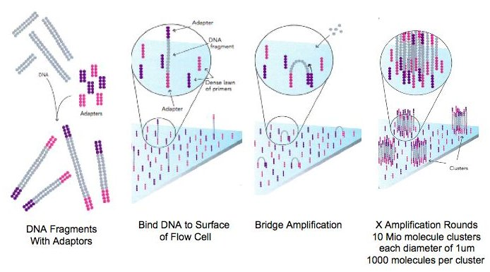
Flow Cell Loading
Illumina HiSeq 2500 Sequencer
Flow Cell

Slide 7
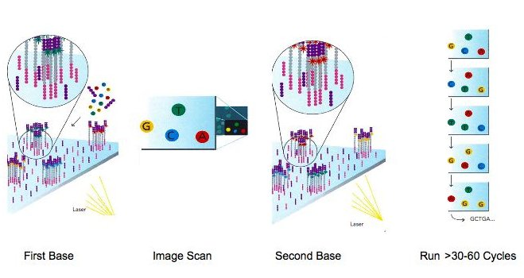
Sequencing Cycles
50-250 cycles.

Slide 8
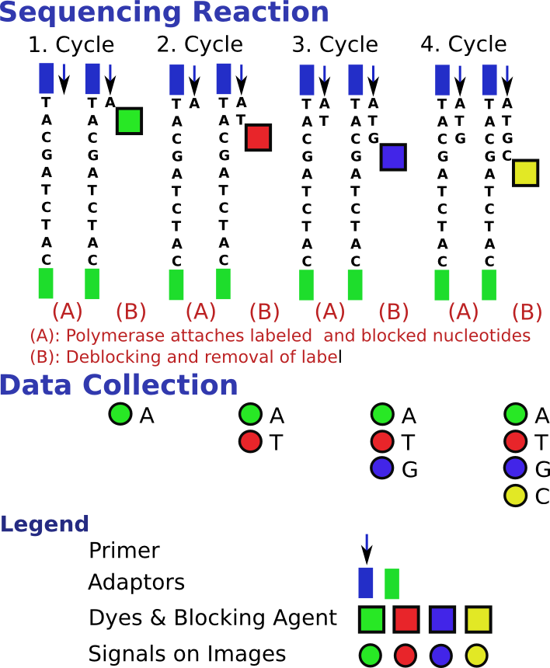
Details of Sequencing Reaction
Illustration shows the sequencing cycles for a single template molecule!

Slide 9
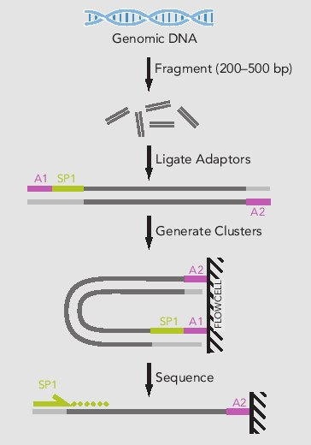
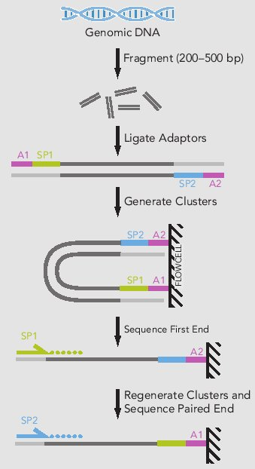
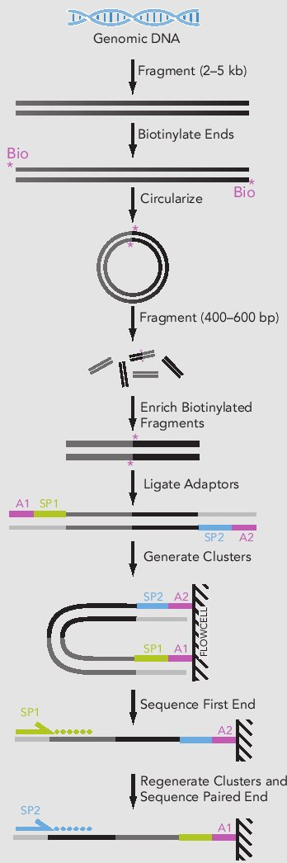
Single End, Paired End and Mate Pair Sequencing
Single End
Paired End
Mate Pair
AP1/AP2: flow cell adapators; SP1/SP2: sequencing primers

Slide 10
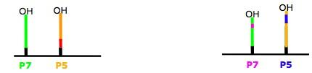
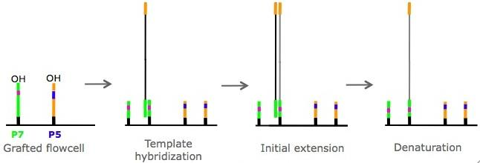
Paired End Chemistry: Step I
Grafted Flow Cell
Single End
Paired End
Linearization: periodate two different enzymes
Cluster Generation: Initial Extension

Slide 11
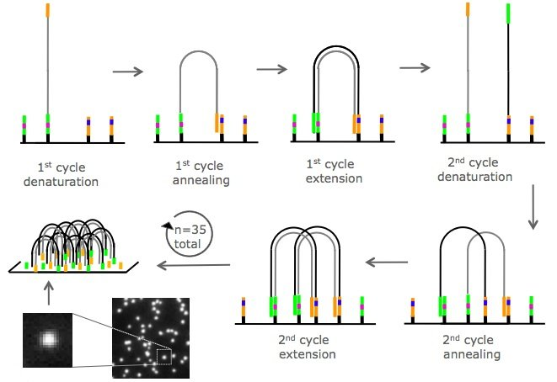
Paired End Chemistry: Step II
Cluster Generation: Amplification

Slide 12
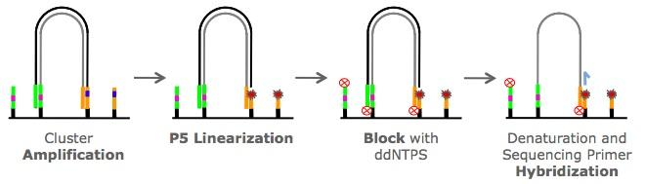
Paired End Chemistry: Step III
Cluster Generation: Linearization
双脱氧核苷酸是DNA聚合酶的链终止性抑制剂，应用于DNA测序桑格法。这些核苷酸亦被称为2',3'-双脱氧核苷酸，常备简写为ddNTPs。

Slide 13
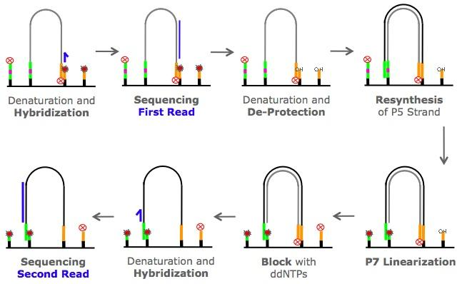
Paired End Chemistry: Step IV
Sequencing

Slide 14
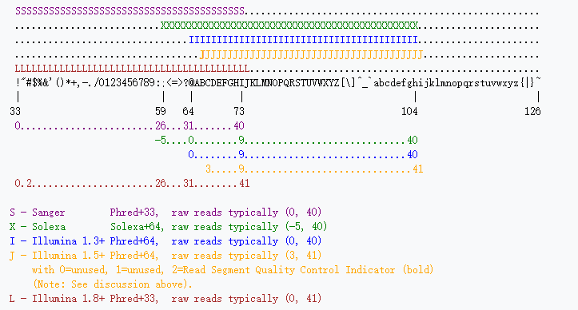
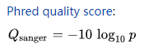
Sequence Format: FASTQ
@SRR446037.238 length=75
TCAGCCTTGCGACCATACTCCCCCCGGAACCCAAAAACTTTGATTTCTCATAAGGTGCCAGCGGAGTCCTATAAG
+SRR446037.238 length=75
IIIIIIIIIIIGIIHIHIIIIIIIIDHDIIIIIFHDGDEFHCCGHHHHHCDDD@?6?@A@?A;??@2@BA@BBB@
... millions of entries ...
FASTQ format has 4 lines per sequence
'@' character followed by a sequence identifier
Character string of sequence
'+' character optionally followed by the same sequence identifier
Quality scores in ASCII format
Further reading: https://en.wikipedia.org/wiki/FASTQ_format

Slide 15
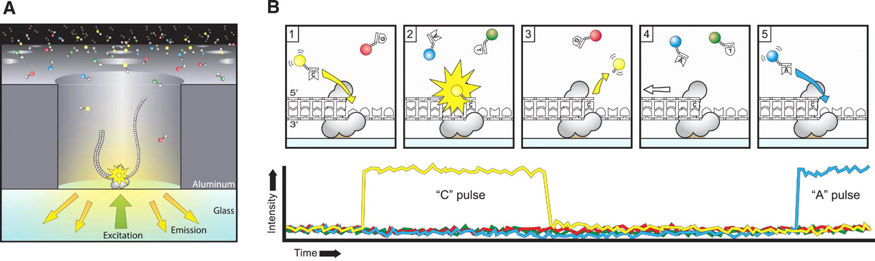
PacBio: Sequencing with Single Polymerase Molecule
Publication: Eid et al 2009
Read lengths: 0.5-20kbp!!
Much lower cost
Disadvantages: high error rate and low number of sequences

Slide 16
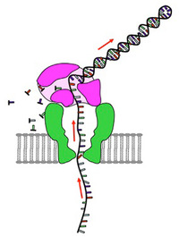
Nanopore Sequencing
Read lengths: xkbp!!
Much lower cost.
Disadvantages: currently higher error rate and low number of sequences.

Slide 17
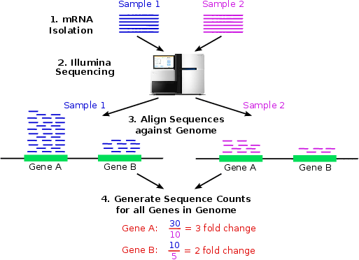
Application: RNA-Seq Gene Expression Profiling

Slide 18
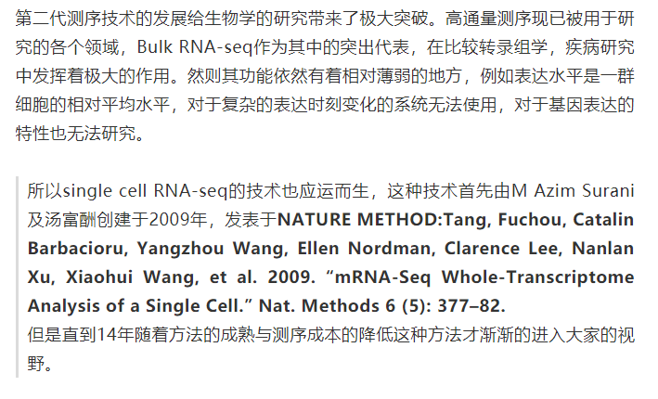
RNA sequencing
Producing valuable transcriptome data of instantaneous cellular state.
More variable, informative, and economical than genome and epigenome?
https://mp.weixin.qq.com/s/4N0LrjkS8m4Tj5eSFAzPkA
Single cell sequencing
Studying heterogeneous systems, e.g. early development studies, complex tissues (Brain)

Slide 19
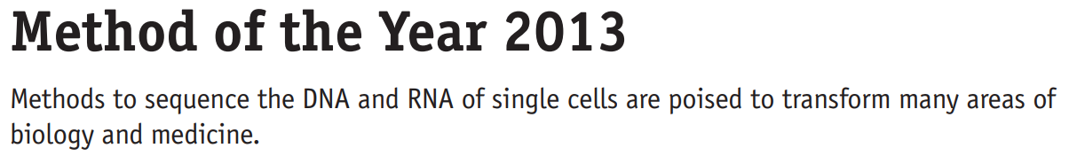
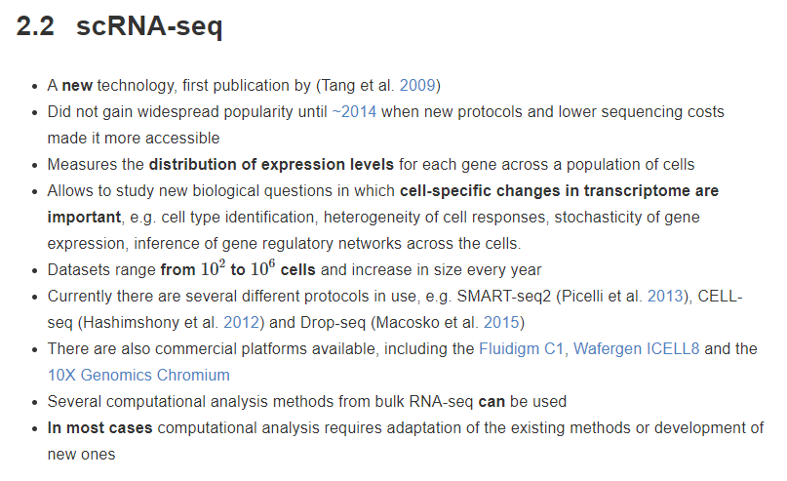
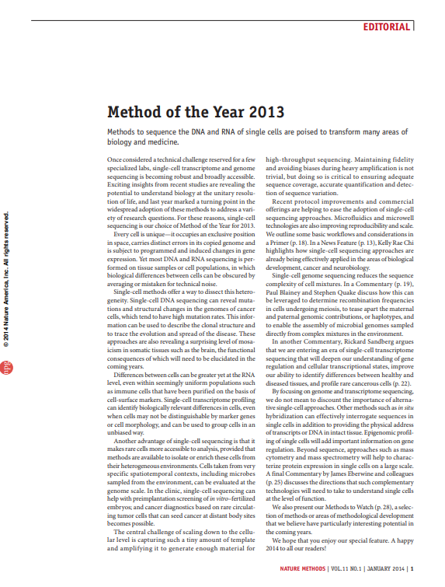

Slide 20
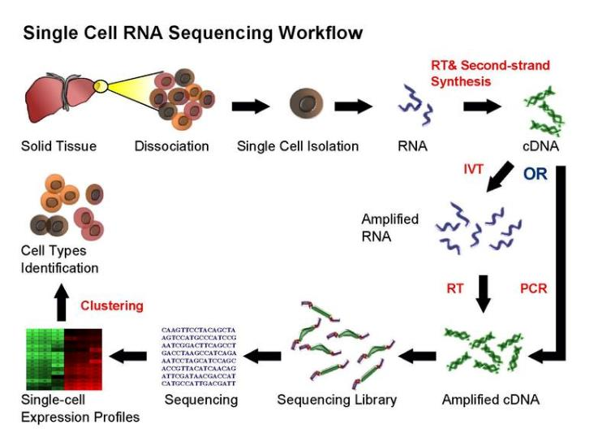
single cell sequencing (taken from Wikipedia)

Slide 21
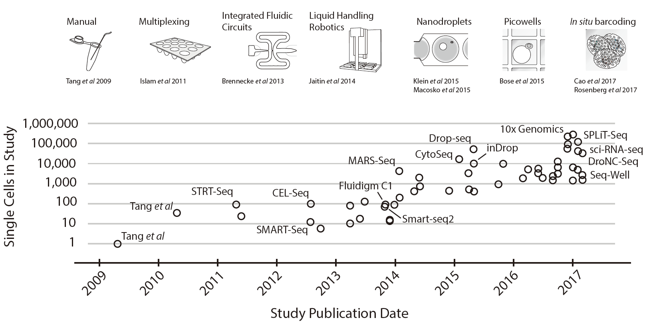
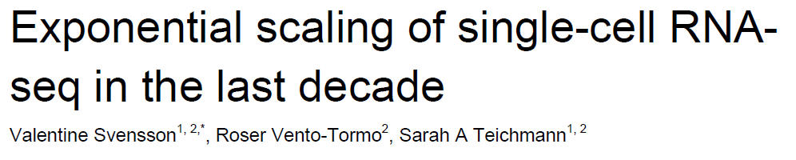
microwell-, microfluidic- and droplet- based

Slide 22
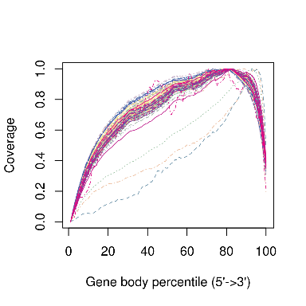
full-length and tag-based quantification
Smartseq2
STRT-seq, 10X
Smart-seq2流程示意图

Slide 23
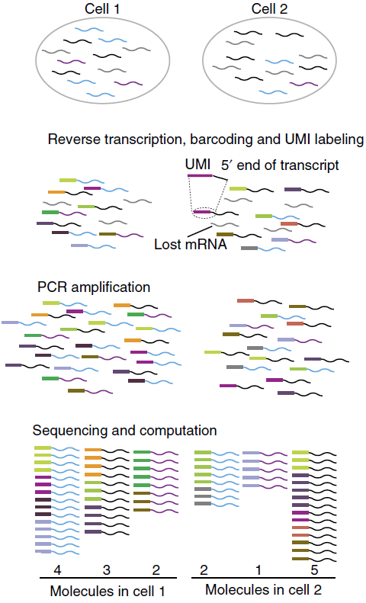
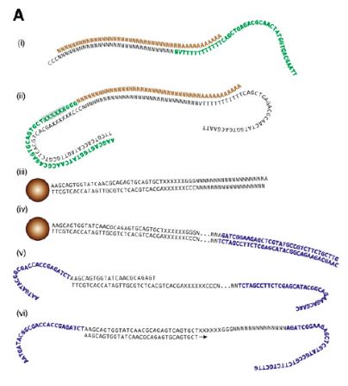
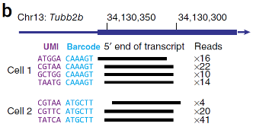
Barcoding and UMIs
Islam et. al, 2011, Genome Biology
Islam et. al, 2013, Nature Methods
STRT-seq流程示意图

Slide 24
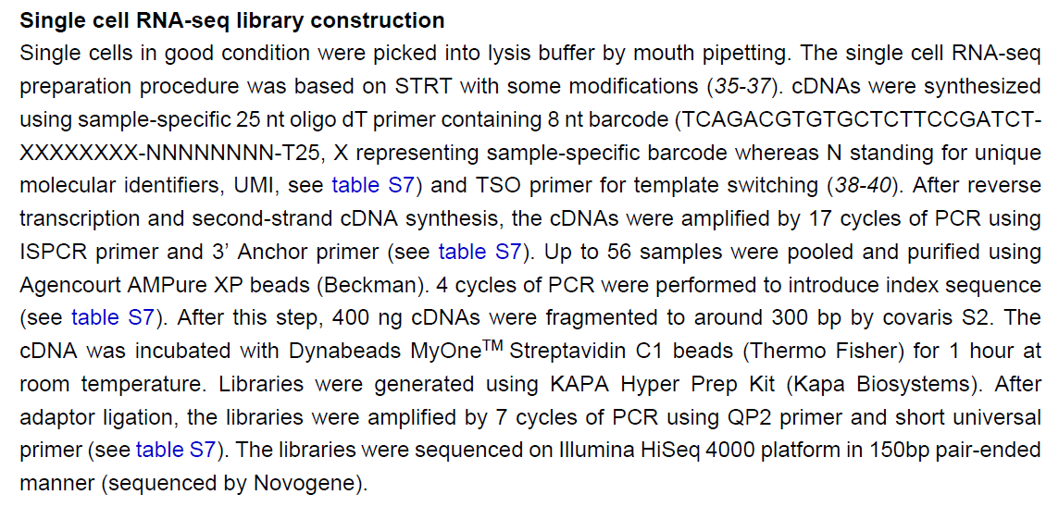
1）流式分选，口吸管挑选单个细胞（单细胞模式流式分选）
2）随机引物（包括 8 nt barcode 序列和 8 nt UMI序列）进行逆转录反应, TSO primer 模板交换
3）之后PCR扩增17个循环（ISPCR 和 3’ Anchor primer）
4）96个细胞的扩增产物合在一起后，用带生物素修饰的引物扩增4个循环
5）将生物素修饰加到扩增产物的3’ 端。
6）300 ng左右的扩增产物进行超声打断
7）Dynabeads® MyOne Streptavidin C1磁珠纯化富集出cDNA的3’ 端
8）用Kapa Hyper Prep Kit（Kapa Biosystems）建库
9）在Illumina HiSeq 4000平台进行测序
Barcode-RT primer96 TCAGACGTGTGCTCTTCCGATCTGCCAAGACNNNNNNNNttttttttttttttttttttttttt
TSO | AAGCAGTGGTATCAACGCAGAGTACATrGrG+G
ISPCR primer | AAGCAGTGGTATCAACGCAGAGT
3' Anchor primer | GTGACTGGAGTTCAGACGTGTGCTCTTCCGATC

Slide 25
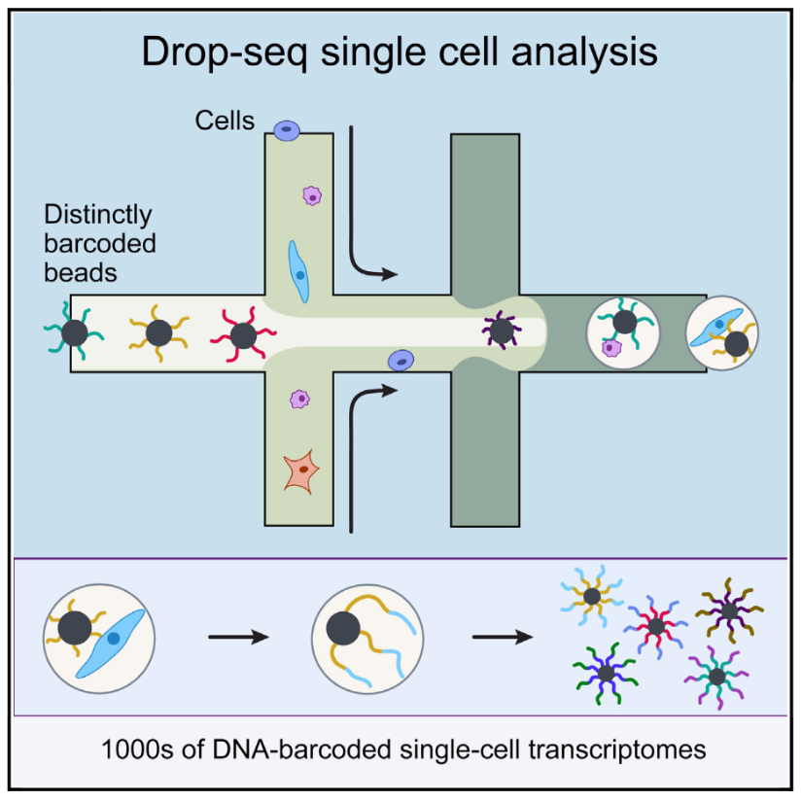
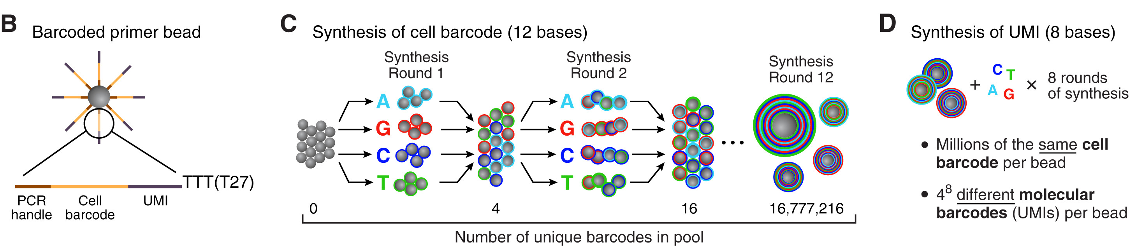
Drop-seq
Molecular Barcoding of Cellular Transcriptomes in Droplets
Macosko et al., 2015 Cell

Slide 26
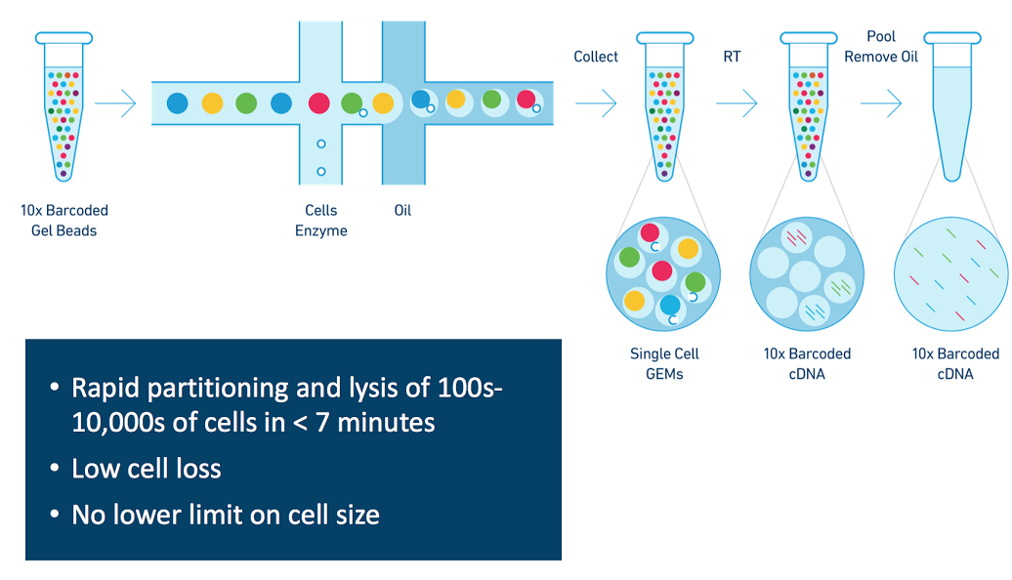
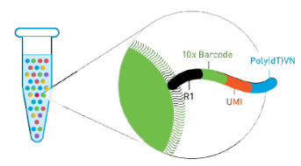
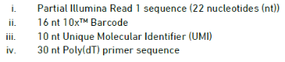
10X

Slide 27
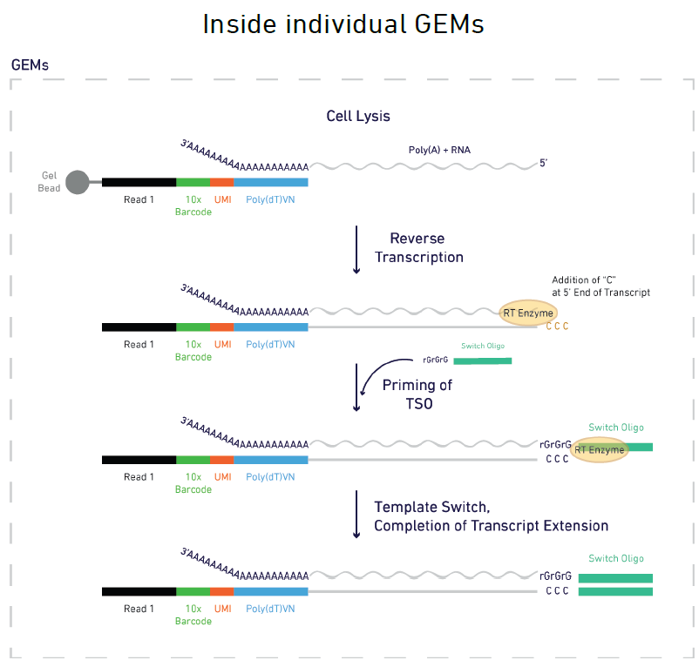
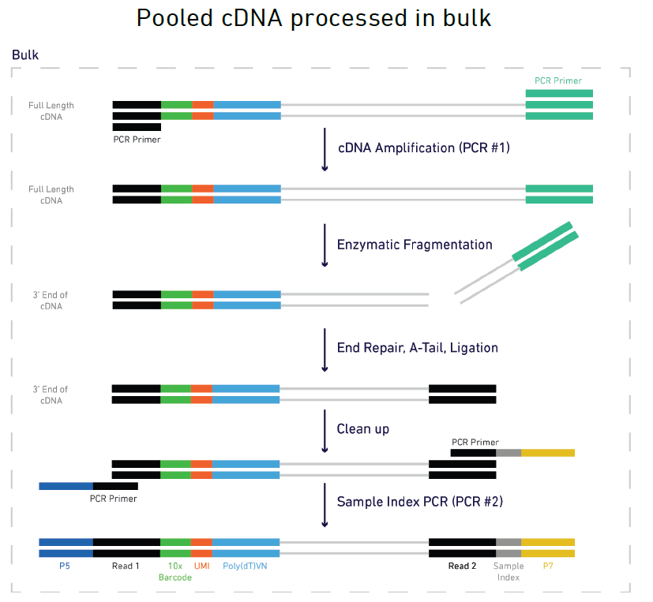
Clean Reads：TSO (head); PolyA, Adaptor (tail)

Slide 28
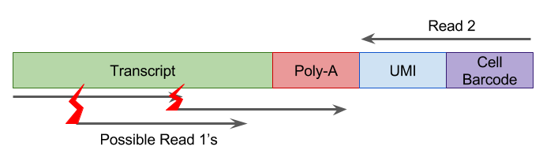
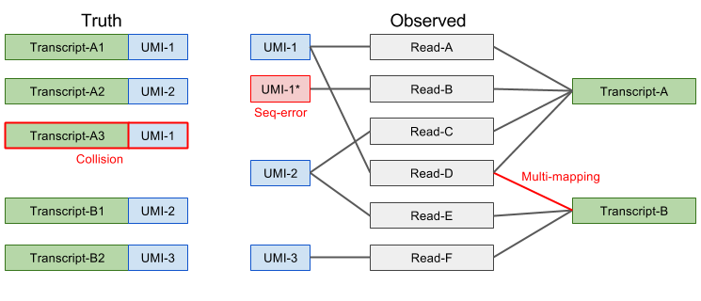
Next Lesson
TSO at 5’
PolyA at 3’
Adaptor at 3’
Gene

Slide 29
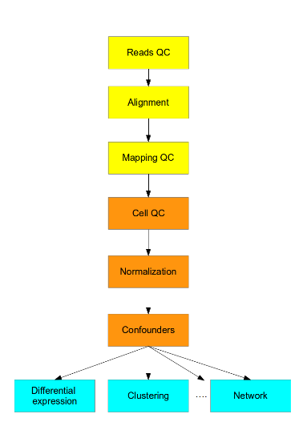
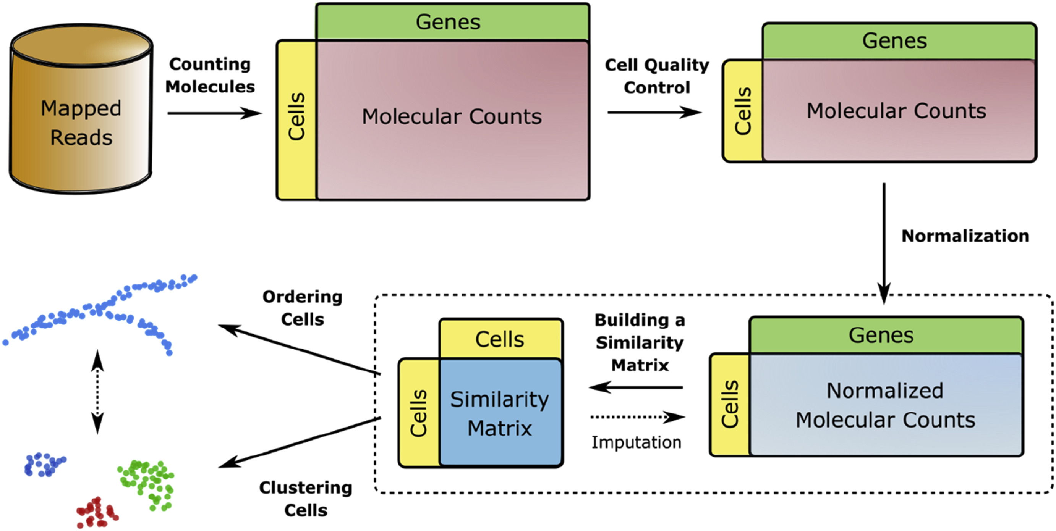
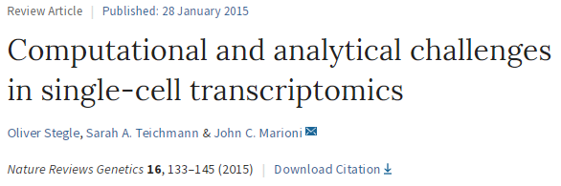
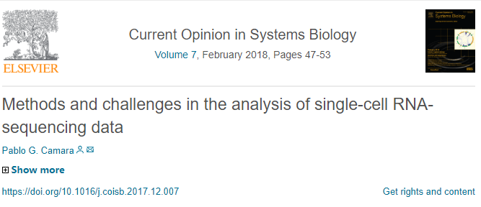
Processing Raw scRNA-seq Data
The structure of a generic pipeline for the analysis of scRNA-seq data.

Slide 30
Smartliu for smartseq2.tangversion
Cellranger for 10X
Other analysis tools for further exploration

